Slide 1
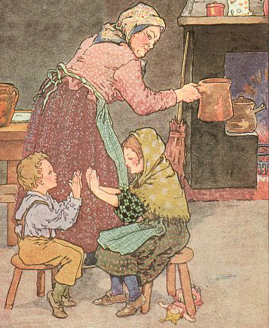
Pease
Porridge
Hot
Volland
Notes:
Pease (clap both hands to thighs) porridge (clap own hands together) hot (clap partner's hands),
pease (clap both hands to thighs) porridge (clap own hands together) cold (clap partner's hands),
Pease (clap thighs) porridge (clap own hands) in the (clap right hands only) pot (clap own hands),
nine (clap left hands only) days (clap own hands) old (clap partner's hands).
(Repeat actions for second stanza)^{[1]}

Slide 2
Pease
porridge
hot
Notes:
Pease porridge hot

Slide 3
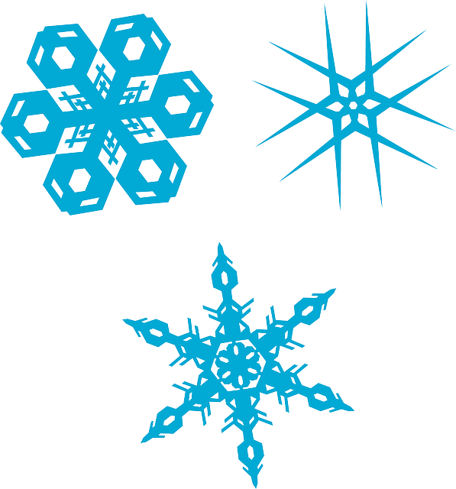
Pease
porridge
cold
Notes:
Pease porridge cold

Slide 4
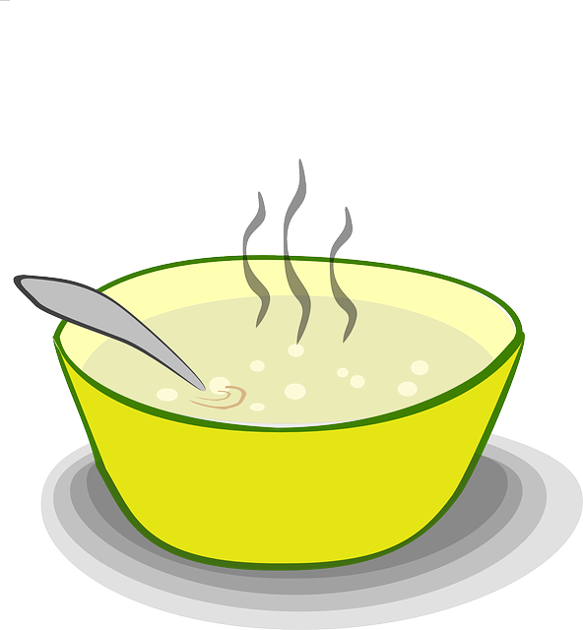
Pease
porridge
in the
pot
Notes:
Pease porridge in the pot

Slide 5
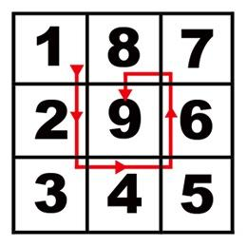
Nine
days
old
Notes:
Nine days old

Slide 6
Some
like it
hot
Notes:
Some like it hot

Slide 7
Some
like it
cold
Notes:
Some like it cold

Slide 8
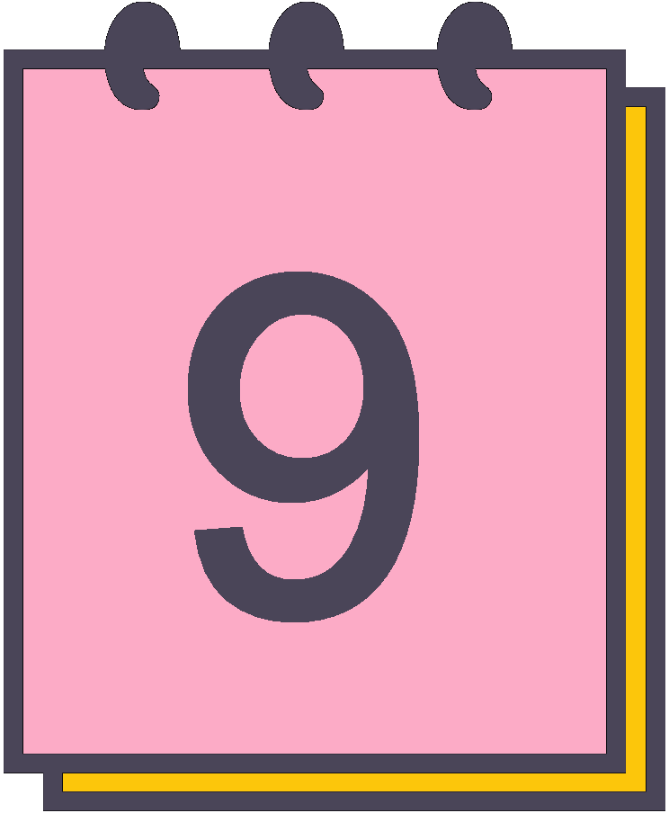
Some like
it in the
pot nine
days
old.
Notes:
Some like it in the pot nine days old.

Slide 9
Thank you
for listening.
Greg Conquest
gregconquest.com

